Slide 1
Desktop Assistant for Gaming
Bailey Goins
Eren Bikmaz
Lehi Briggs
Morgan Anderson
Notes:
Lehi
(Lehi Continues)

Slide 2

Our Project
A general focus on the gaming demographic
Overlays
Controlling second screen with voice commands
Integration with popular software used by the gaming demographic
Notes:
Lehi
(Eren Next)

Slide 3
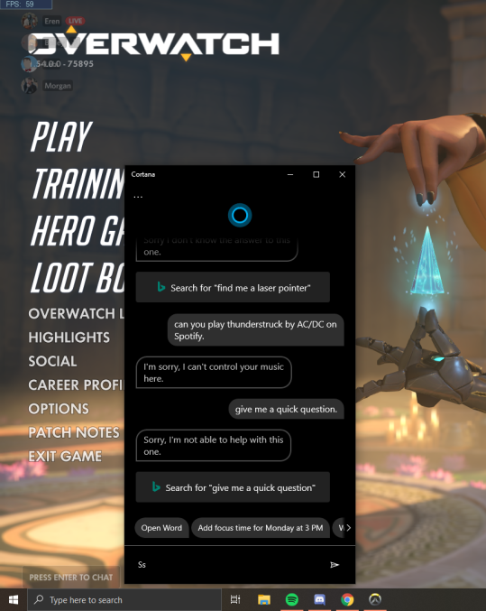
Changes in scope
Originally envisioned a meta-assistant
Shifted focus towards pc-gaming demo
More recently, decided to not integrate with other platforms (discord) due to TOS violations
Core focus is now basic web functionality hands-free
Notes:
Eren
(Morgan Next)

Slide 4

Previous Sprint Goals
Connect and test front/backend connection
Implement “Hey Pal” functionality
Take pal to grammar school (fix linguistic issues)
Look into selenium alternatives
Deep-dive into ingame overlays
Notes:
Morgan
(Bailey Next)

Slide 5
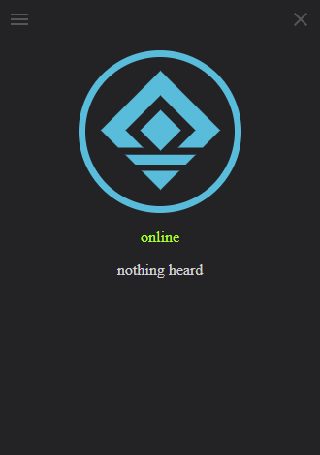
Sprint Results
The Good
“Hey, PAL” functionality - hands free operation
Secure backend connected to user interface - data entered into GUI stored in database
Optimized our workflow - stand up scrums, established standards for scrum masters
The Bad
Technical issues (breaking TOS, changing scope)
Productivity issues (compilers, statistics, physics, overall burnout)
Notes:
Bailey
(Lehi Next)

Slide 6

Goals For Our Next Sprint
Create a custom user messaging system as backup to preferred messaging system
Create a solution to displaying Overlay on top of game
Expand the amount of command types
Create a Frontend Storage System to hold Authorization tokens
Notes:
Lehi
(Demo Next)

Slide 7
Demo

Slide 8
Eren, Bailey- “Hey Pal”

Slide 9
Morgan, Lehi - Backend

Slide 10
Questions, Comments, Concerns?

